Slide 1
BitcoinHeist: Topological Data Analysis for Ransomware Detection on the Bitcoin Blockchain Authors: Cuneyt Gurcan Akcora, Yitao Li, Yulia R. Gel,Murat Kantarcioglu Published in IJCAI, 2020
By Nabila Chowdhury
COMP 7570 Blockchain Data Analytics

Slide 2
Introduction
Malicious Usage of Cryptocurrency
Rise of cryptocurrencies
Pseudo-anonymous transactions
Criminal abuse of blockchain (e.g. Ransomware)
Motivation
Detect ransomware payments
Current approaches depend on heuristics
Incorporation of data science tools
Contribution
ML techniques for ransomware related Bitcoin address detection.
Efficient framework to extract features
Development of TDA
Detection of new ransomware families

Slide 3
Preliminary
Ransomware
A type of malware that encrypts or locks a victim’s data
Communication using anonymity network (e.g. TOR)
Demands ransom(asks to send certain amount of bitcoins to send a bitcoin address) for decryption tool

Slide 4
Preliminary
Bitcoin Graph Model
Bitcoin graph as a heterogeneous network with two node types: addresses and transactions.
A directed weighted graph G = (V, E, B)
Each address node is linked via a transaction node to another address node

Slide 5
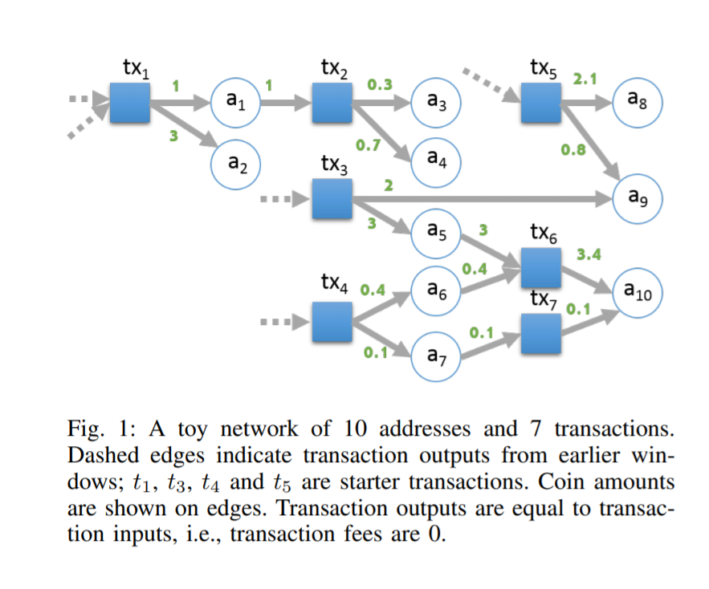

Slide 6
Methodology- Graph Features for Classification
Income of an address u is the total amount of coins output to u
Neighbors of an address u is the number of transactions which have u as one of its output addresses
Weight of an address u, W_{u}, is defined as the sum of fraction of coins that originate from a starter transaction and reach u

Slide 7
Methodology- Graph Features
Length of an address u, L_{u}, is the number of non-starter transactions on its longest chain
Loop of an address u, O_{u} is the number of starter transactions which are connected to u with more than one directed path
Count of an address u, C_{u} is the number of starter transactions which are connected to u through a chain

Slide 8
Methodology
Classification and clustering models
Similarity Search
Heuristics
Co-spending
Transition
Unsupervised Approaches
DBSCAN density clustering
Hierarchical clustering
Tree based approaches
Extreme Gradient Boosting Trees
Random Forest

Slide 9
Methodology
TDA Mapper
Detection of ransomware patterns on Blockchain
Consistent results under noisy data collection scheme
Mapper method- a customizable TDA tool
Mapper often recovers hidden data pattern

Slide 10
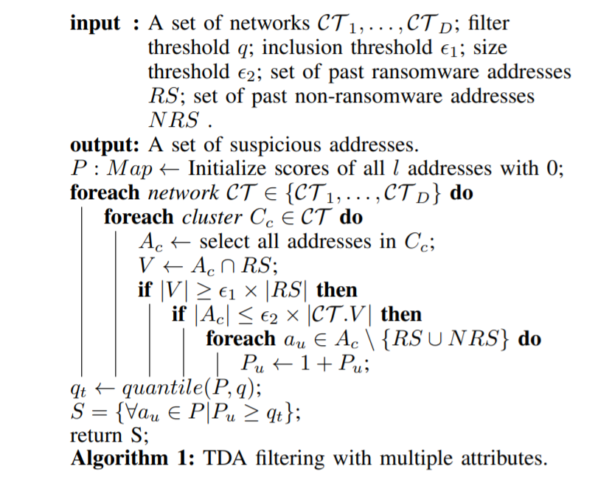
Methodology
TDA mapper graph is filtered using each six graph features
CT 1, . . . , CT 6 for each time window
Threshold q on addresses, and label addresses suspicious only if they are in the top 1−q of all addresses
Two parameters: inclusion and size to control the clusters
Inclusion limits what can be learned when very few ransomware addresses are contained in the cluster.
The size threshold prevents learning when cluster includes too many addresses

Slide 11
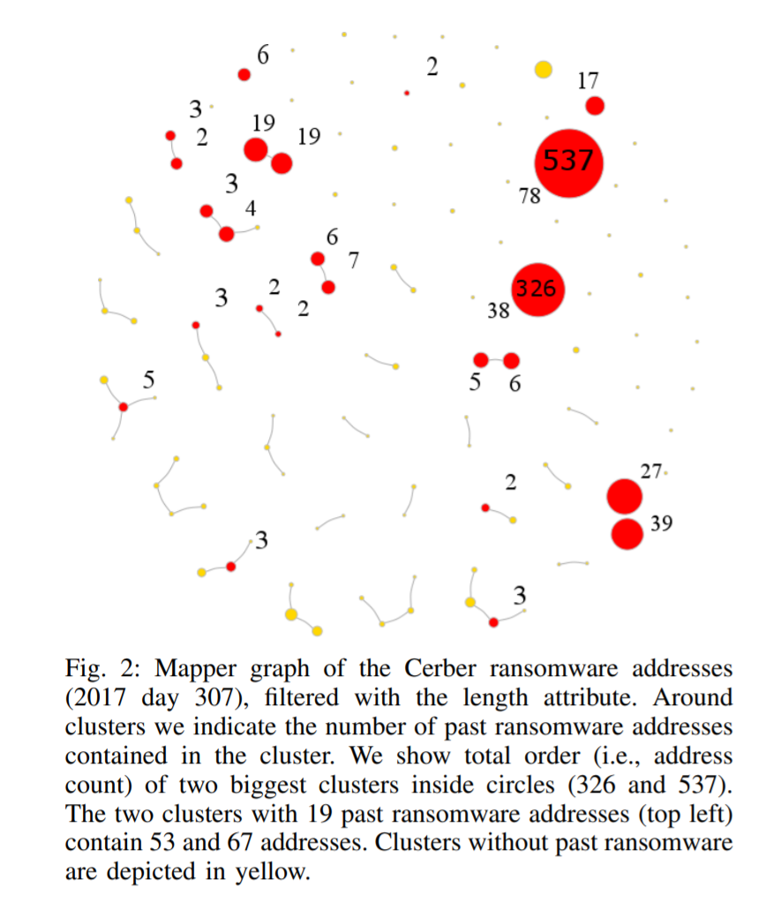

Slide 12
Ransomware Behavior
Dataset
Bitcoin transaction graph from 2009 January to 2018 December
Ransomware dataset union of datasets from adopted studies of Montreal, Princeton and Padua
Dataset contained 24,486 addresses from 27 ransomware families

Slide 13
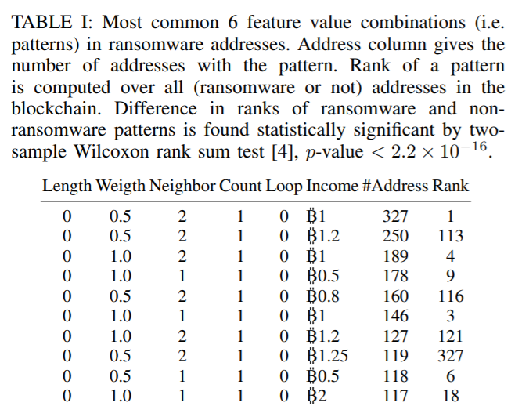
Ransomware Behavior
A summary on ransomware features

Slide 14
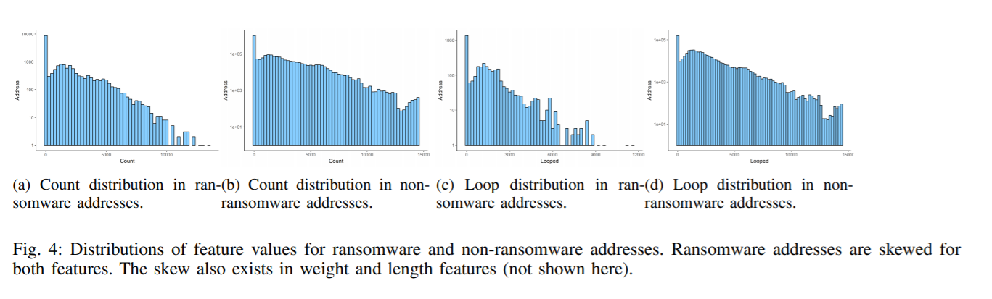
Ransom Behavior

Slide 15
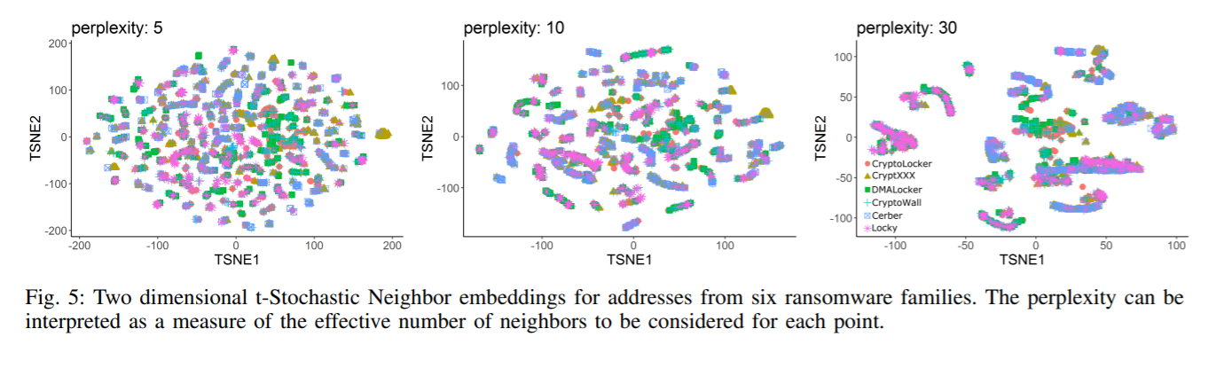
Feature Relevance for ransomware behavior

Slide 16
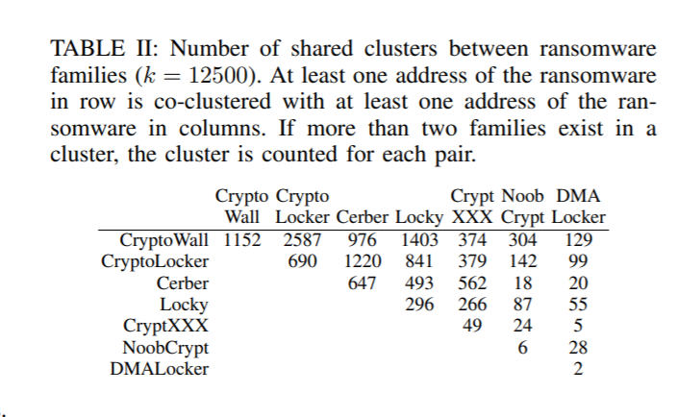
Ransomware behavior similarity

Slide 17
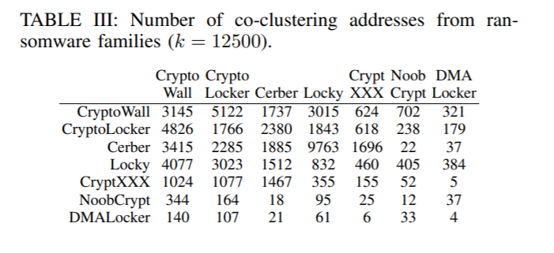
Ransomware behavior similarity

Slide 18
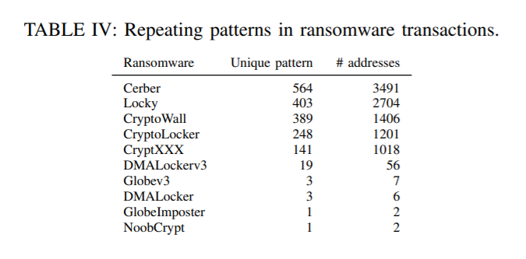
Address features over time

Slide 19
Ransomware Detection And Prediction
Factors and Metrics are considered to train the model
Class Imbalance
To limit the number of non-ransom addresses
Temporal Variation
To avoid disappeared ransomware families during a certain window
Metrics
Precision
Recall
Positive likelihood ratio (PLR)

Slide 20
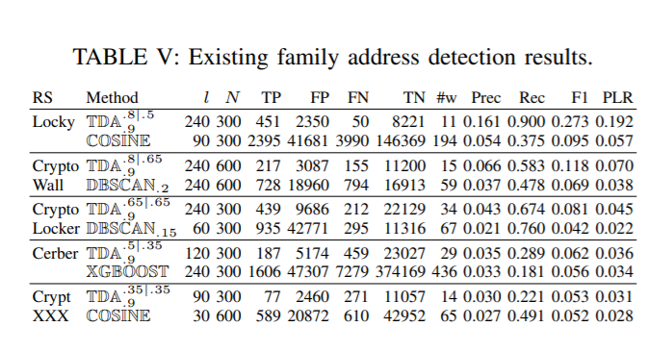
Ransomware Detection and Prediction
Existing Family Detection
TDA has a hyper-parameter set that produces the best model, For each ransomware family
The best non-TDA model is also offered for comparison
Locky ransomware has the best results with a precision of 0.161 and recall of 0.9

Slide 21
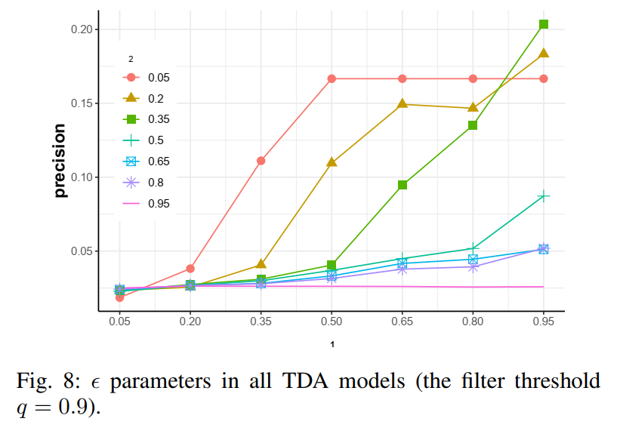
Ransomware Detection and Prediction
TDA models appear to be sensitive to the selected hyper-parameters
TDA models tend to be more sensitive to ε₂ value
On average higher precision is reached by limiting ε₂ to small values

Slide 22
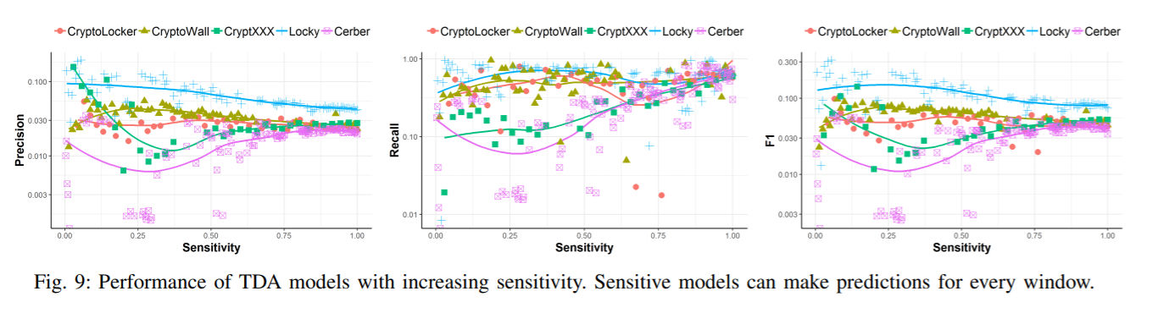
Ransomware Detection and Prediction

Slide 23
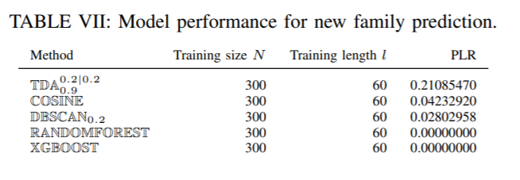
Ransomware Detection and Prediction
New Family Prediction
Given previous data of ransomware families, tries to predict emergence of new ransomware families

Slide 24
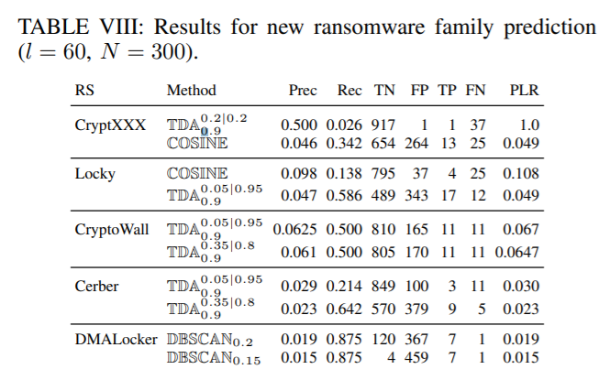
Ransomware Detection and Prediction
CryptXXX, TDA predicts only two ransomware addresses, one of which is a true positive
This result offers evidence that mentioned prediction models can be highly effective for certain families of ransomware

Slide 25
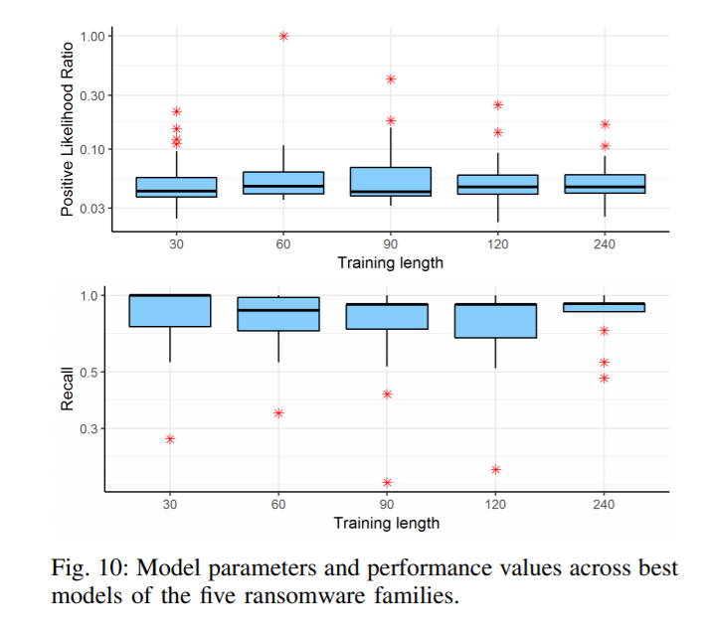
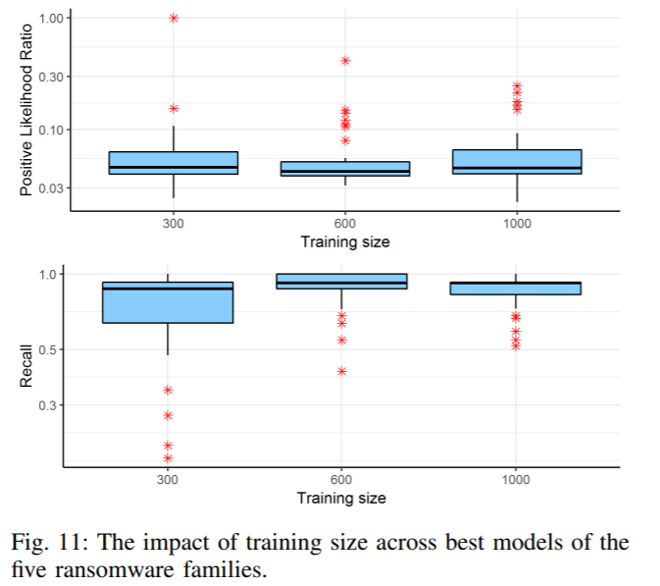
New Family Prediction

Slide 26
Address Elimination
Three filtering approaches on the results produced by the models in family detection
Shape Elimination
Graph Elimination
Multisig Elimination
Results of these elimination heuristics offer strong evidence that the suspected addresses are ransomware related.

Slide 27
Questions for Audience
Fig. 4 displays that patterns are skewed for ransomware. What is the significance of this pattern?
Can TDA filtering use weighted feature-based approaches?

Slide 28
An Empirical Analysis of Traceability in the Monero Blockchain Authors: Malte Möser, Kyle Soska, Ethan Heilman, Kevin Lee, Henry Heffan, Shashvat Srivastava, Kyle Hogan, Jason Hennessey, Andrew Miller, Arvind Narayanan, and Nicolas Christin Published in Proceedings on Privacy Enhancing Technologies, 2018
By Nabila Chowdhury
COMP 7570 Blockchain Data Analytics

Slide 29
Introduction
Monero is a privacy preserving cryptocurrency system with a current market capitalization of slightly more than a billion dollar.
Monero is based on cryptonote protocol which obscures the transaction graph by including chaff transaction inputs called “mixins”

Slide 30
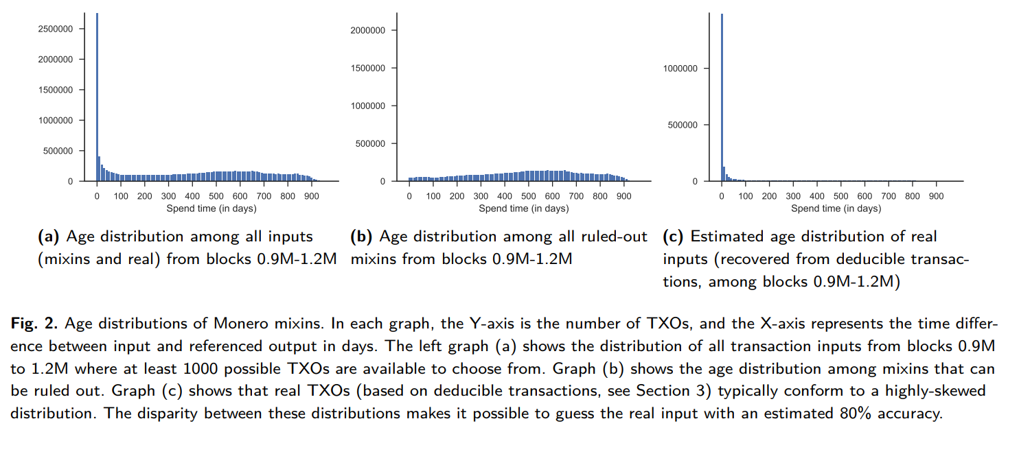
Observed Weakness in Mixins:
Prior to February 2017, all monero transactions contain deducible mixins.
Mixins are sampled from a distribution that does not resemble real spending behavior.

Slide 31
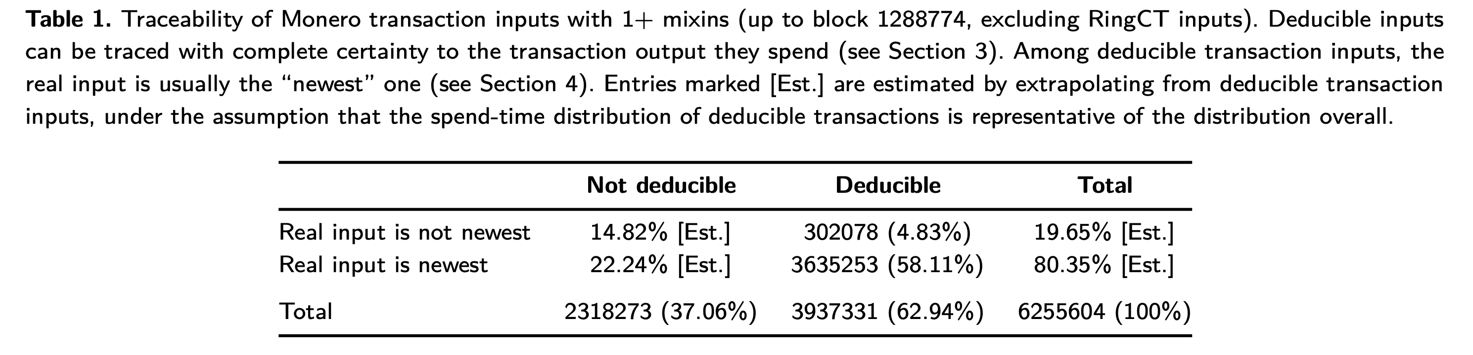
Real Input is usually the newest:
Authors come to this conclusion based on the results from the deducible monero transactions

Slide 32


Threat Model:
Alice has some monero coins
Alice wants to conduct a privacy sensitive transaction. So Alice performs a pseudo-anonymous transaction
Alice wants that no one should be able to link the transaction back to her
Attacker has two information: The withdrawal transactions from the exchange (which contain withdrawal information by Alice) and the deposits at the place where Alice conducted the sensitive spending
The attacker’s goal is to link the deposit at the spending place to a withdrawal at the exchange

Slide 33
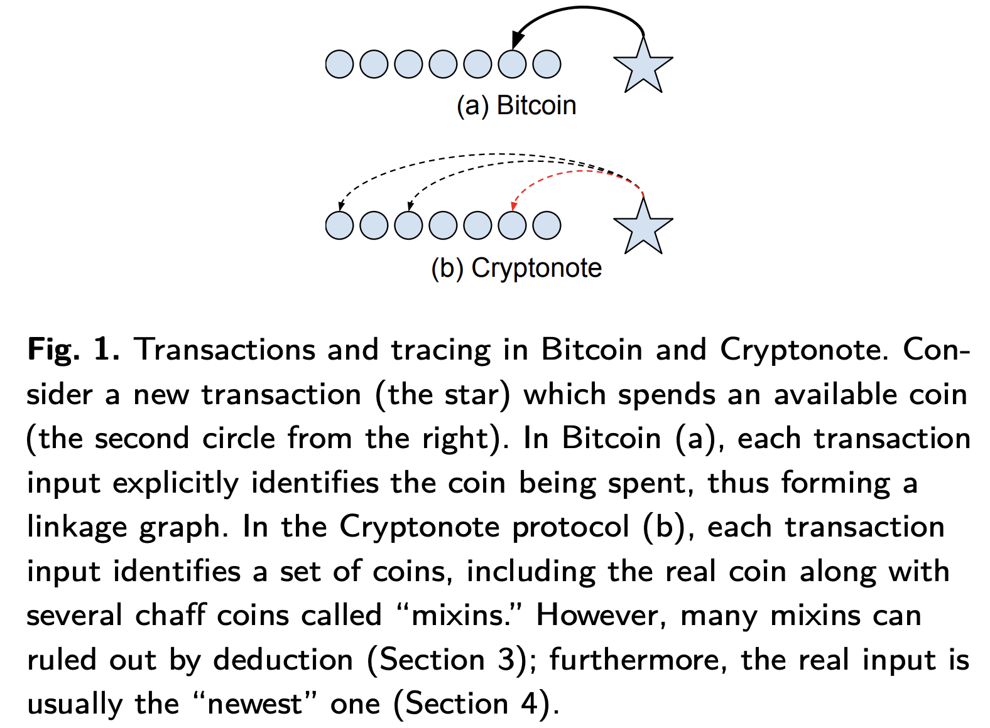
Cryptonote: The privacy model of Monero
Obscures transaction graph and obstructs traceability.

Slide 34
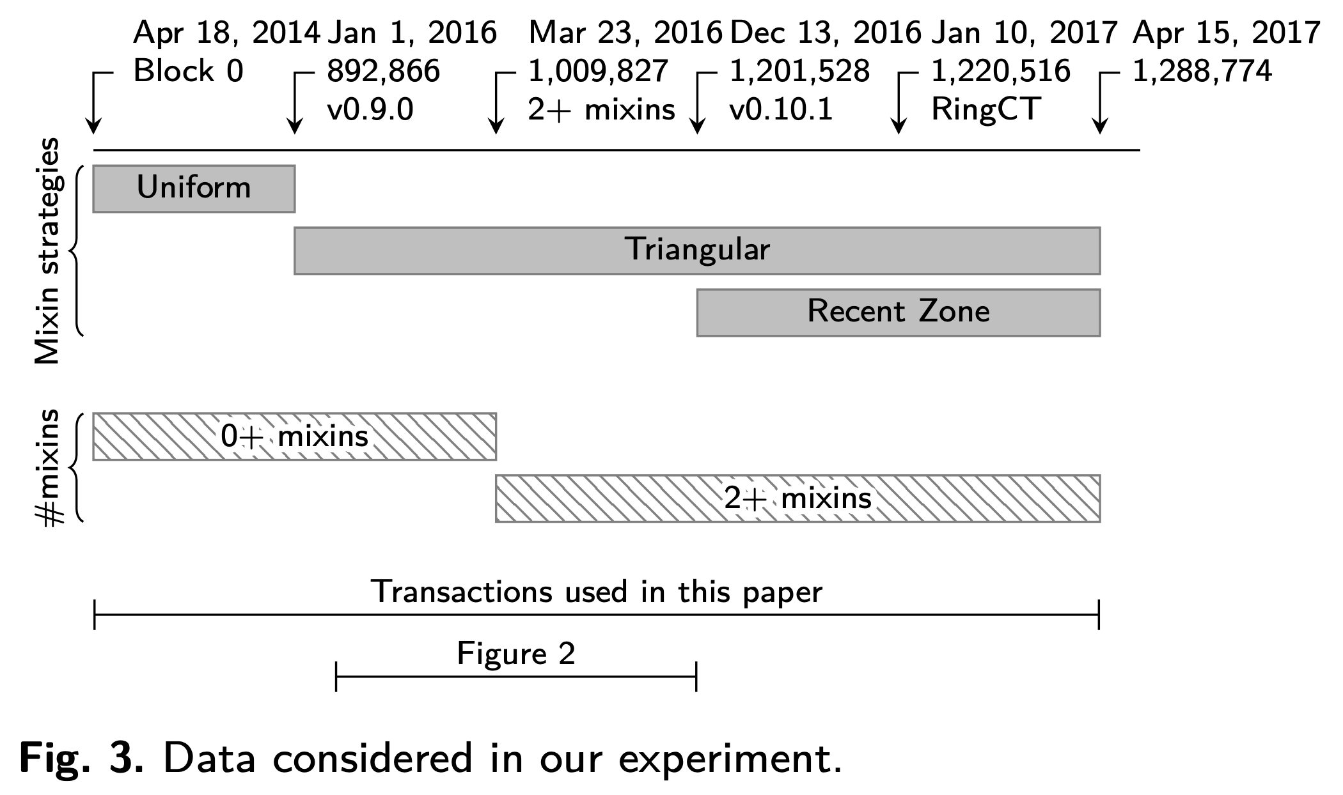
Choosing Mixin Values in Cryptonote
Initially Monero allowed users to use 0 mixin. However, on Mar 23, 2016, they enforced a 2+ mixin rule which was increased to 4 mixin minimum on Sep 7, 2017

Slide 35
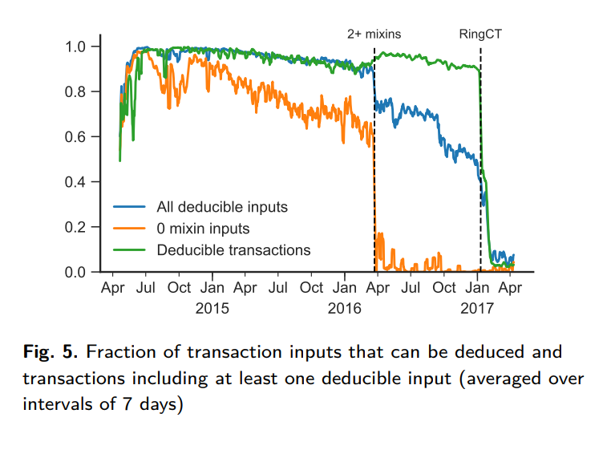
Deducible Monero Transactions

Slide 36
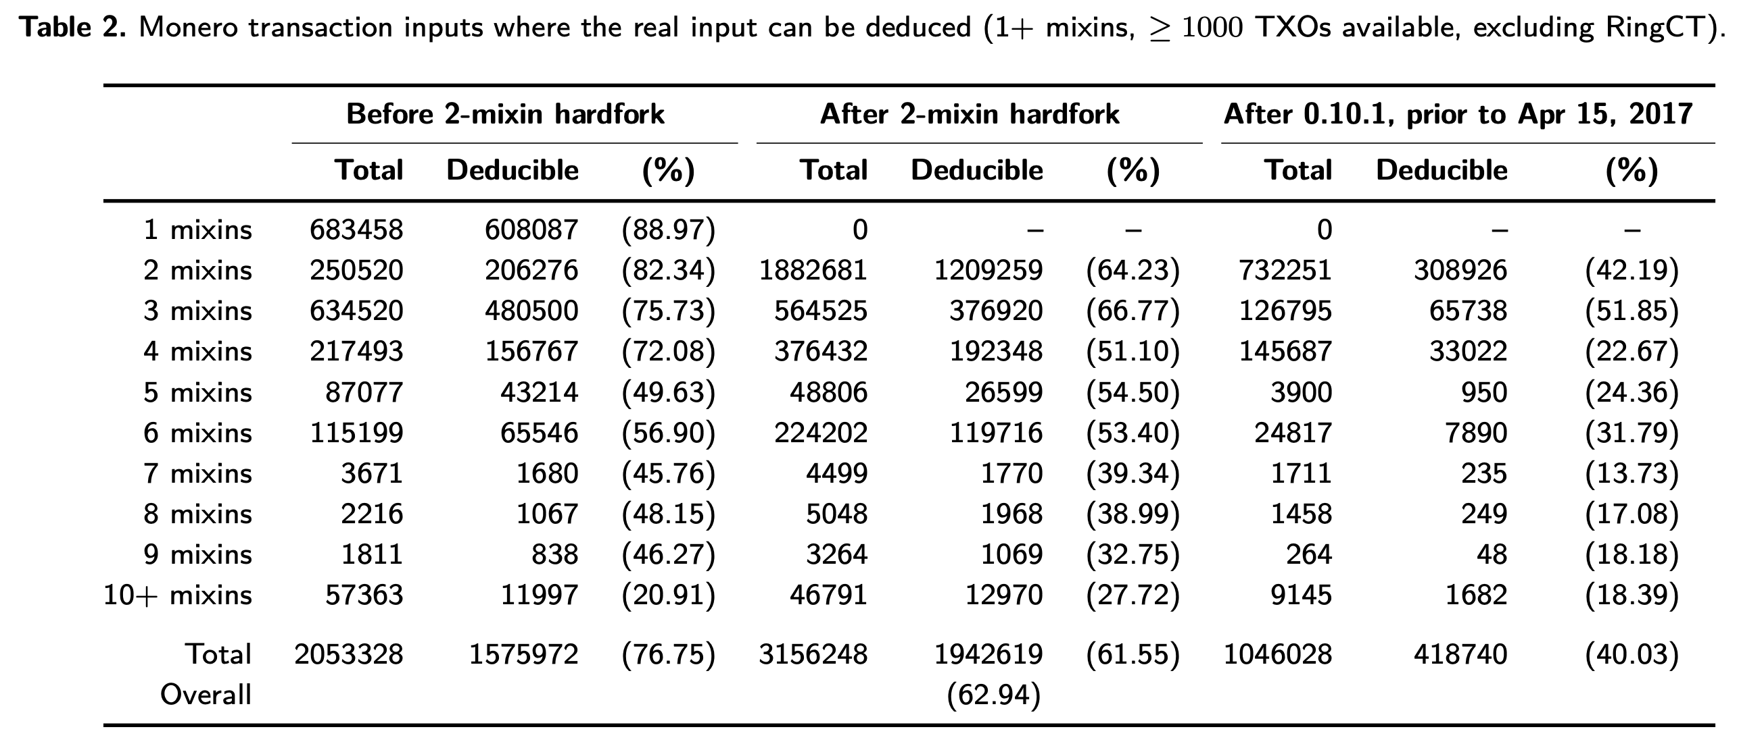
Overview of Deducibility

Slide 37
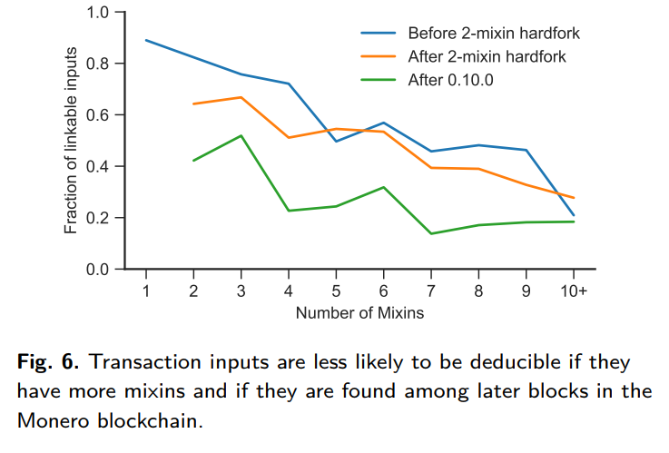
Overview of Deducibility

Slide 38
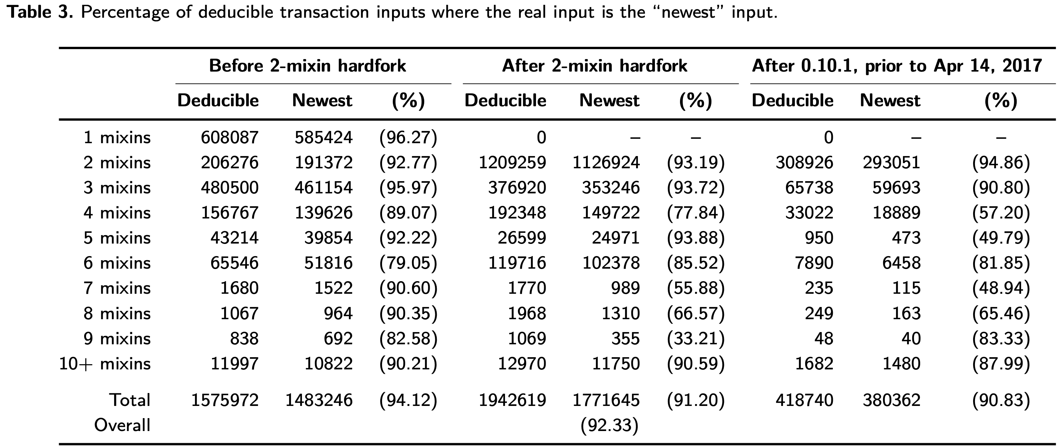
The guess-newest heuristic
Among the inputs, usually the newest one is the real input, and the older ones are chaff inputs.
In order to validate the heuristic, the authors run a monte carlo simulation.

Slide 39
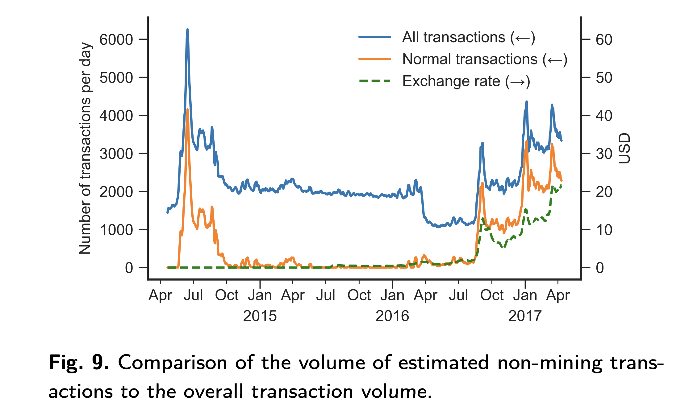
Mining Characterization in Monero
Normal Transactions follow closely the line of all transactions
After mid 2016, when the 2+ mixin rule was enforced, number of transactions increased
Number of transaction increases caused the monero exchange price to increase

Slide 40
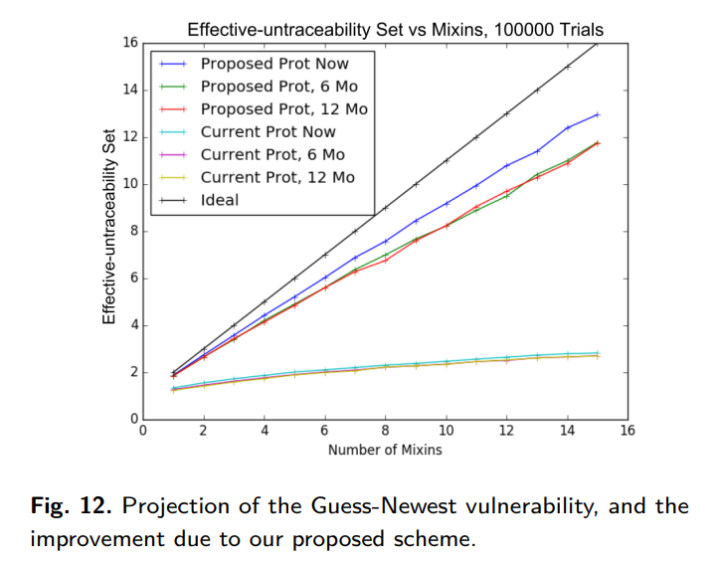
Counter Measures: Matching the actual distribution
Instead of randomly choosing mixins, the authors chose mixins from the distribution that matches the real inputs spend-time behavior and thus difficult to identify. This is called Fitted Mixin Sampling Distribution
Proposed method increases untraceability, however, still can not reach ideal level

Slide 41
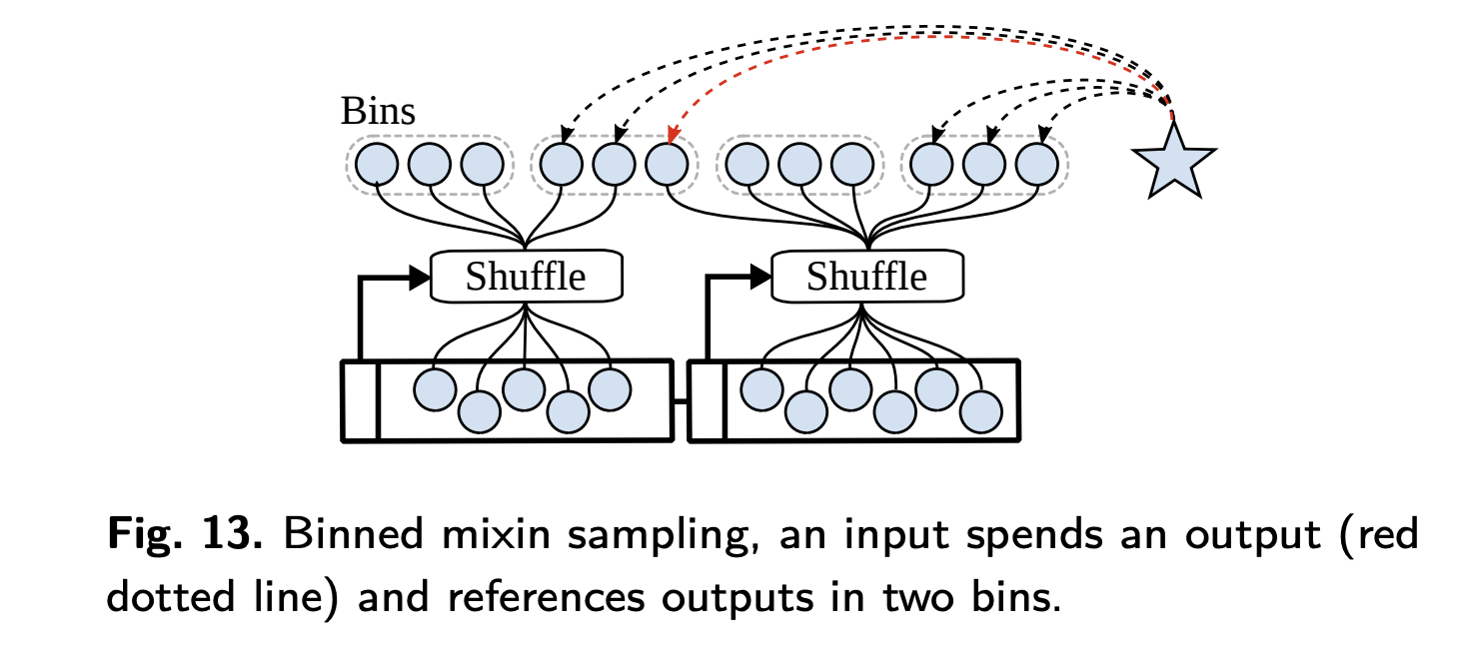
Counter Measures: Binned Mixin Sampling
An input spends an output and references it to two or more bins
Since there are more than 1 bins involved an attacker can not actively find out where the mixin inputs will be coming from and thereby fails to isolate the actual input in the next transactions

Slide 42
Discussion and Recommendations:
The mixing sampling distribution should be modified to closer match the real distribution
Avoid including publicly deanonymized transaction outputs as mixins
Monero users should be warned that their prior transactions are likely vulnerable to tracing analysis

Slide 43
Questions for Audience
How is effective untraceability is related to guessing entropy?
Why the ideal effective untraceability set is linearly related to the number of mixins?

Slide 44
Thank You

